Slide 1

E-Card Creator

Slide 2
Introducing E-Card Creator
An app use to create a virtual credit/debit card in your android screens.

Slide 3
Quick Tour of the E-Card Creator

Slide 4
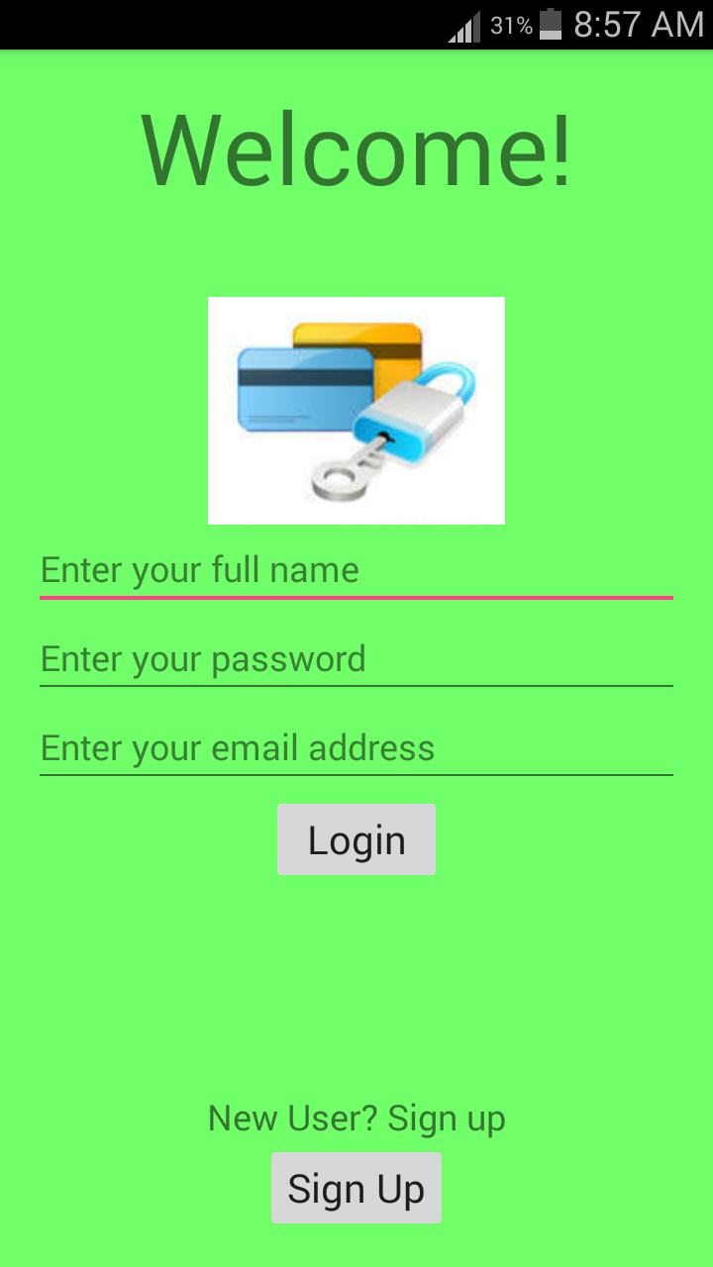
Welcome Screen
Allows user to Login
If new user, allows to SignUp

Slide 5
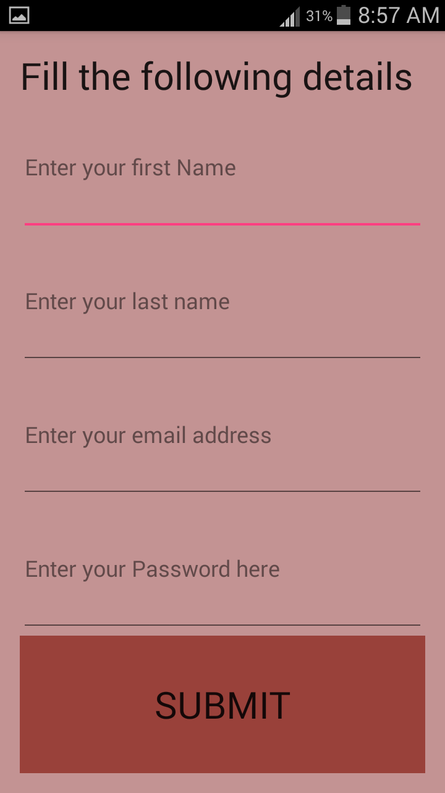
SignUp Screen
Inputs some basic information of the app..

Slide 6
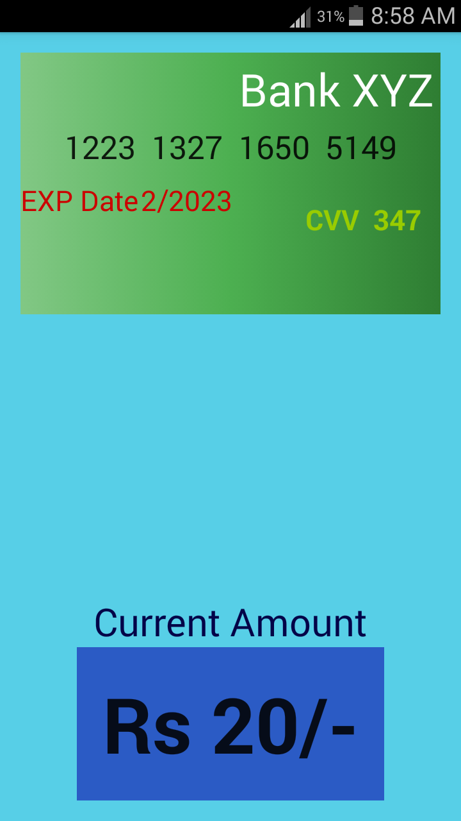
Home Screen
Creates a unique virtual credit/debit card of Bank XYZ as per user
Displays the current amount in that card
Swipe leftwards for more options

Slide 7
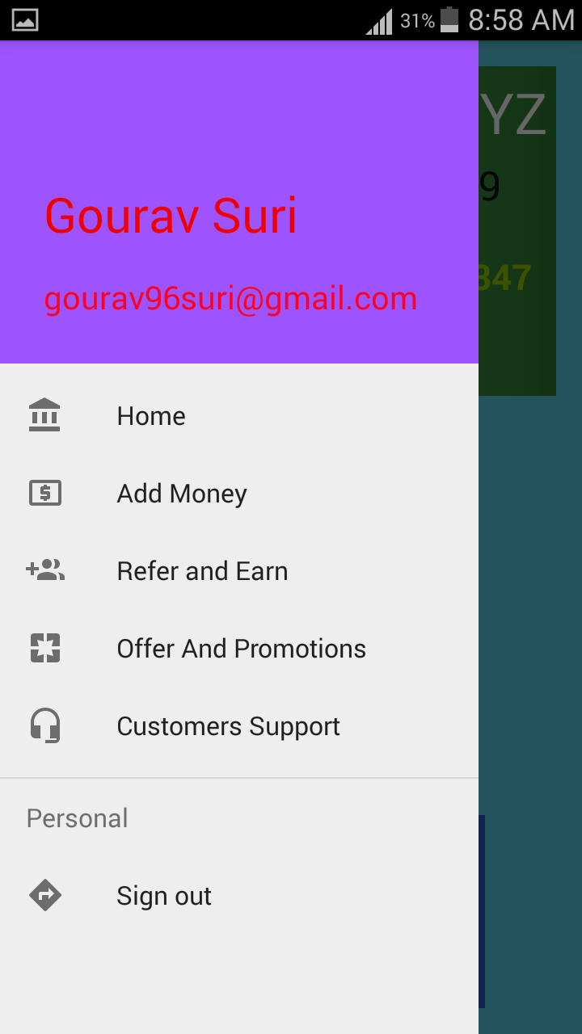
More Options
Home
Add Money
Refer and Earn
Offer And Promotions
Customers Support
Sign Out

Slide 8
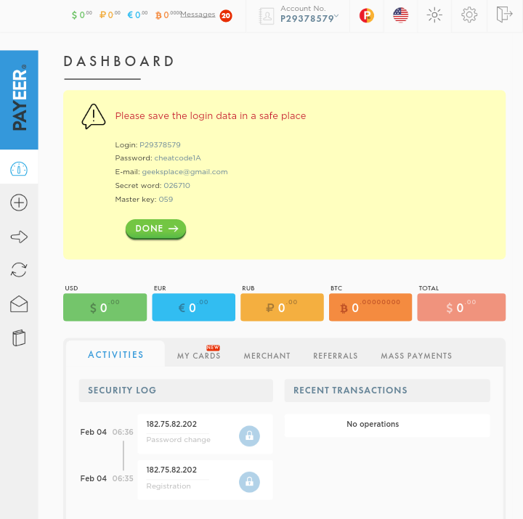
Home
Launches your current wallet status

Slide 9
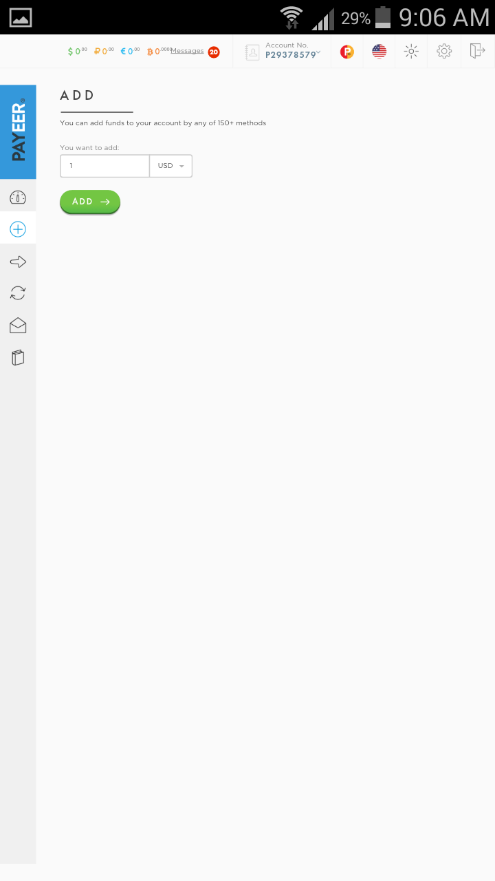
Add Money
Allows to make transactions with this card..

Slide 10

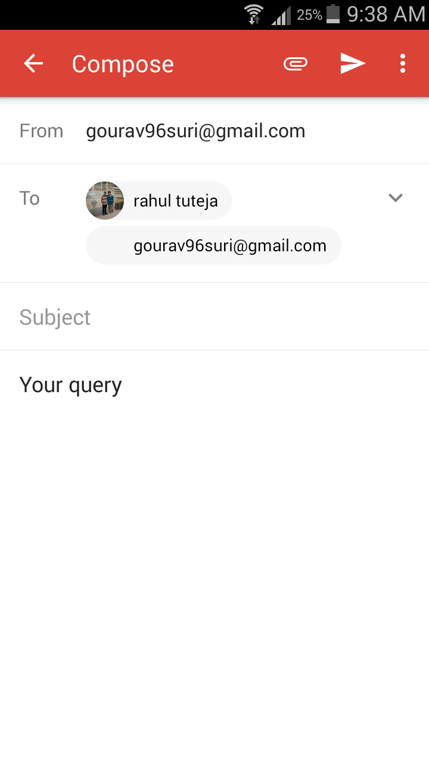
Customers Support
Allows user to enter their queries and send them to us via gmail..

Slide 11
Features
Creates a virtual debit/credit card
Allow user to make cash transactions with this card
Allow user to make purchases through this card
Customers Support Service

Slide 12
Upcoming Features
Will allow user to deactivate the card (virtually created/ real card) if it gets stolen..
(No need to go to banks and do formalities)
Refer and Earn Others to get rewards and cash in your virtual card..
Will soon update Offers for the user
Will soon add a feature to create DD via this app

Slide 13
Advantages
No need to carry debit cards along with you now!
Reduces the risk of card getting stolen!
Create a card of any bank now (provided if banks agree to “affiliate with” & “sponsor to” this app)
RTGS and NEFT Service available for 24 X 7 via this app unrespective of restricted timings of banks
Hustle Free bank experience

Slide 14
Solution to Problems
Problem:
Google Playstore Registeration accepts some specific banks credit/debit card for online transaction (One of the accepted banks is Indian Bank), there is a probability that you may not have an account in any one of the accepted banks (One of the ‘Not’ accepted banks is SBI). Now How will you gonna register for its Playstore??
Solution:
Use this app, it will generate a virtual bank credit/debit card for Indian Bank (if this app will affiliated with this bank in future). Now add money to your virtually generated credit/debit card through this app and use this card for registeration..

Slide 15
THANK YOU

